Slide 1


DotNet Development
Capabilities
FlairMinds
Innovation, Resilience, Efficiency

Slide 2


Agenda
What is .NET:
Introduction to .NET
Benefits of outsourcing .NET development
FlairMinds’ approach and experience:
Approach at FlairMinds
Technology and capabilities at FlairMinds
Case studies
Contact
Confidential - Work Document

Slide 3
What is .NET?

Slide 4
What is .NET?
.NET is a cross-platform, open-source developer framework for building many different kinds of applications. Naturally, its open-source nature means that it’s free of charge.
Developers can use .NET to build applications ranging from web and mobile to desktop, games, and even the Internet of Things (IoT).
Developers can write .NET apps using C#, F#, and Visual Basic
Benefits of development using .NET
Web
IoT
Mobile
Cloud
.NET
Desktop
Fast backend development
Scalability
Cost-effective maintenance
Security
Cross-platform support
High performance
Large ecosystem
Machine Learning
Micro services
Gaming
Confidential - Work Document

Slide 5
Benefits of outsourcing .NET development
Reduced time-to-market
Focus on core business objectives
Advantages of Outsourcing .NET Development
Opportunity to delegate project management
No need for the in-house team
Reduced development cost
Better expertise & timely delivery
Variety of engagement models
Confidential - Work Document

Slide 6
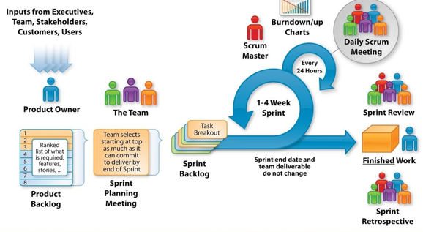
Approach at FlairMinds
At FlairMinds, we follow agile scrum methodology to ensure timely and quality delivery of .NET projects whenever the end to end deilivery ownership is outsourced to FlairMinds team
Confidential - Work Document

Slide 7
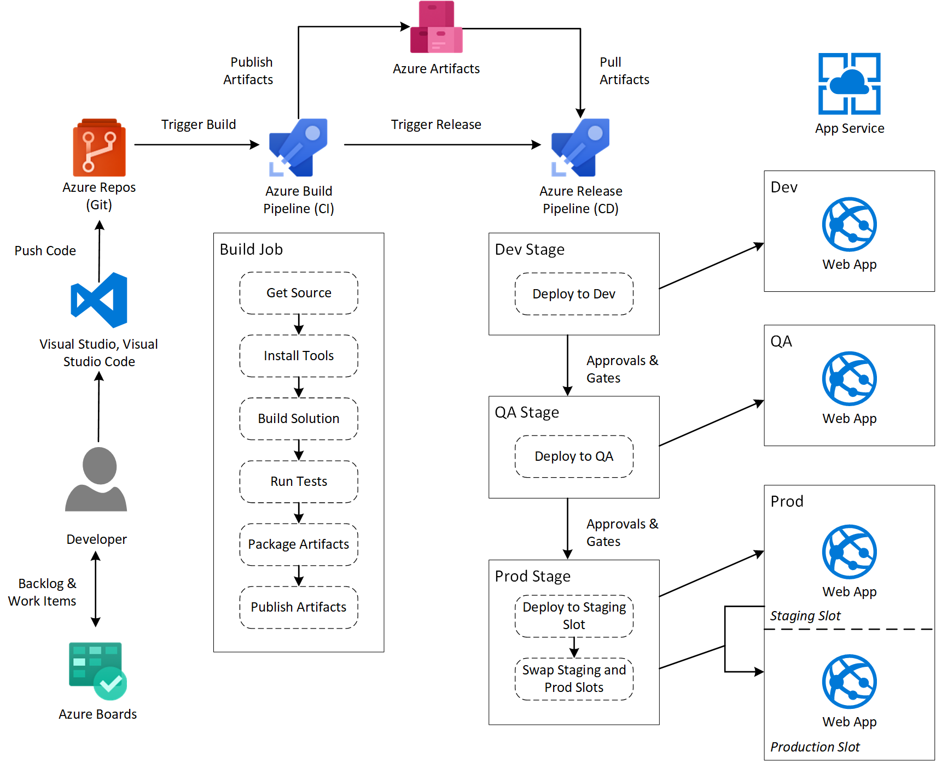
Approach at FlairMinds
At FlairMinds, we leverage Azure DevOps to ensure timely and quality delivery of .NET projects
Confidential - Work Document

Slide 8

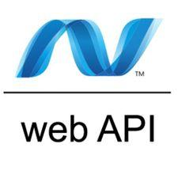


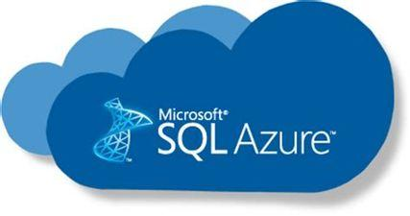


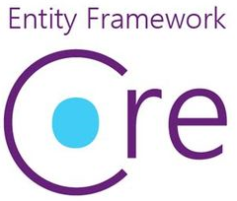

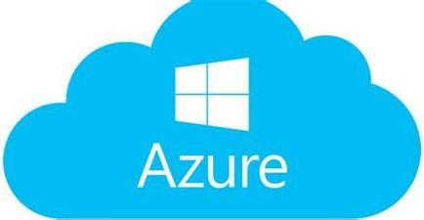


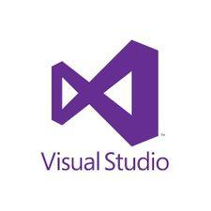
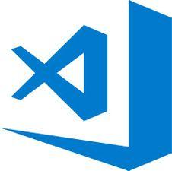


.NET Ecosystem & Services at FlairMinds
Ecosystem
Services
FRONTEND
MOBILE
BACKEND
DATABASE
SaaS Development
Web App Development
Mobile App (Native / Hybrid) Development
Windows Desktop App Development
WinForm
ADO.NET
ML & IoT
Data Analytics
Azure DevOps
Infra Management & Support
PLATFORM, TOOLS & DEVOPS
Confidential - Work Document

Slide 9
Technologies at FlairMinds
Development Class | Technology Skills Set @ Flairminds
FrontEnd Development | C#, ASP.NET MVC (Core), HTML, CSS, JavaScript Angular, React WinForm, WPF
Mobile App Development | Xamarin, MAUI, React Native, Ionic, Flutter
Backend Development | C#, ASP.NET Web API, WCF, WF, ADO.NET ORMs such as Dapper, Entity Framework (Core)
Database | MS SQL Server, SQL Azure MySQL, PostgreSQL, Oracle NoSQL Databases such as MongoDB
Cloud Services / SaaS | Azure App Service, Functions, Service Bus & Queues, Storage, Azure AD, LogicApps, Data Factory, etc.
Machine Learning | ML.NET, ML algorithms such as - Linear regression, KNN, Random forest, SVM, XGboost etc
Tools | Visual Studio, VS Code, SQL Server Management Studio, Git, JIRA, Trello, Azure Dashboard
Confidential - Work Document

Slide 10



Contact
NAGPUR OFFICE
Infosane Technologies llp Nagpur, Shop No. 168, RAJAT SANKUL Opp. S.T. Stand, Near Hotel Rahul Deluxe GANESH PETH, Nagpur, Maharashtra 441108,India
PUNE OFFICE
FlairMinds Software Pvt. Ltd. 11, Soormani, 163 D.P.Road, Opposite DAV School, Aundh, Pune, 411007, India
sales@flairminds.com
+91 9967 650 472
www.flairminds.com
Confidential - Work Document

